Slide 1
Dietary: a Cloud-based Nutriment & Fitness Assistant (fact-based) Android App for Bangladeshi Youths.
CSE 299 Development Progress Week - 07
Presenting By : Group 1
Date : 03.09.2020

Slide 2

Agenda
Preview
Fitness Assistant
User Assistant
Dataset Processing
Conclusion
Reference
Q/A Segment

Slide 3
Preview
Complete User Interface
Authentication using Firebase
Fitness Assistant (Busy Life Based)

Slide 4


Fitness Assistant
User
Assistant
Workflow
Help
(guideline, Q/A using
Chatbot)
Weekly workout day
(get workout routine
for every day)
Details
(description with image)
Regular life based
Select Set
(description about how
many set required)

Slide 5
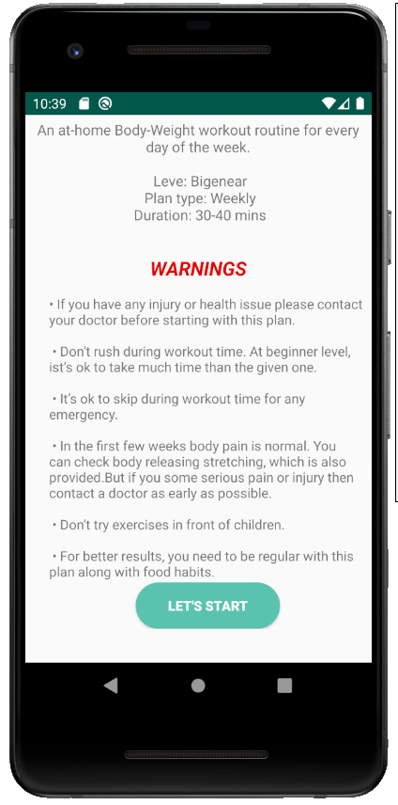
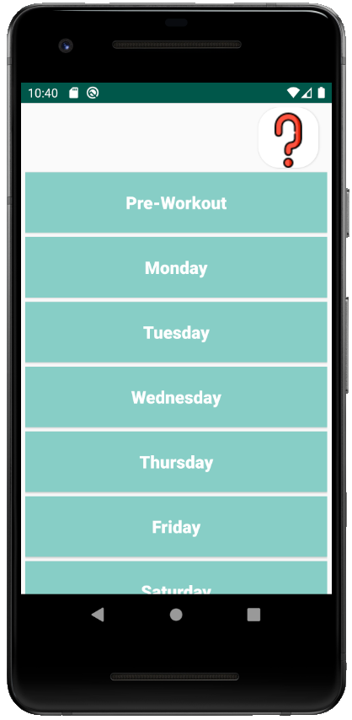
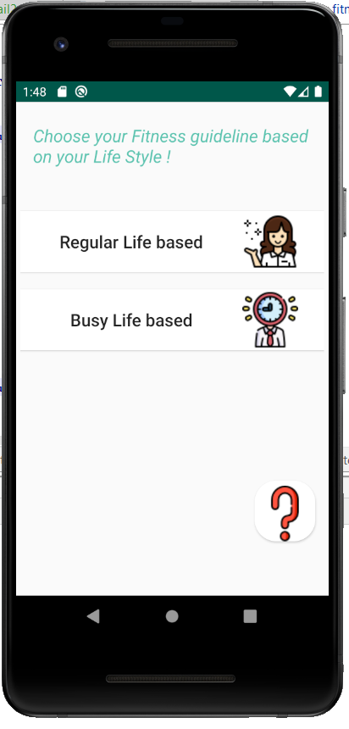
Fitness Assistant
Screenshot

Slide 6
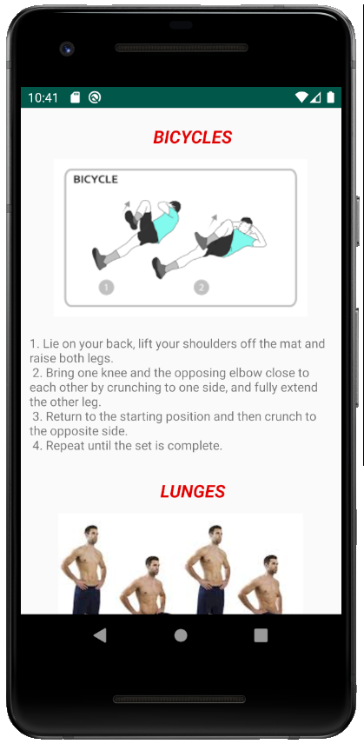
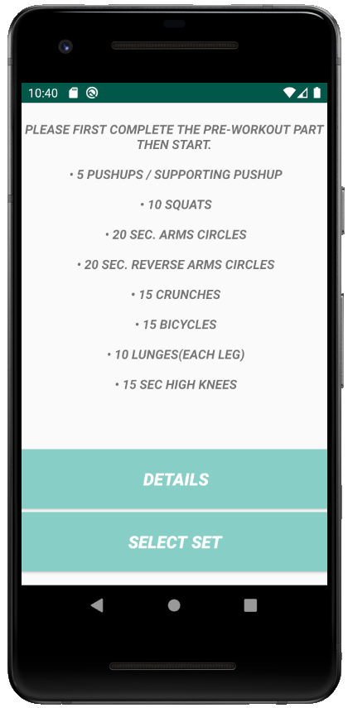
Fitness Assistant
Screenshot

Slide 7
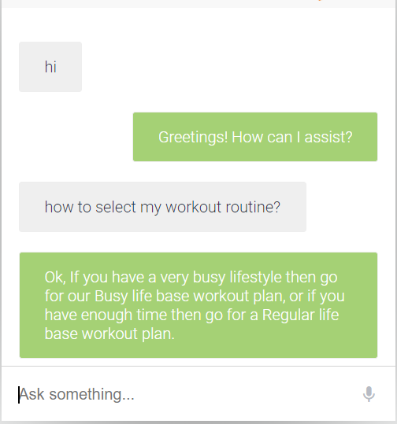
User Assistant
This chatbot is able to respond with both text & voice.
Used API to integrate this bot with App.

Slide 8
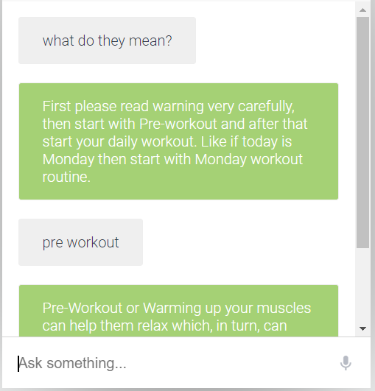
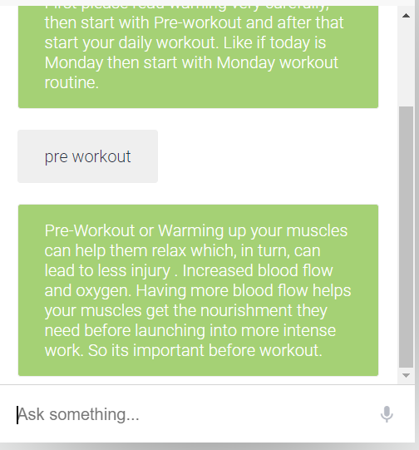
User Assistant

Slide 9
Dataset Processing
Dataset collected “data.world”
This data is a flattened version of the USDA National Nutrient Database.
This dataset contains 41 features. [ like food group(breakfast, snacks, lunch, etc), their description, and how much kilocalories, carbs, proteins, fats, vitamins, etc.]
We working on 3 Features. [ like food group, description & energy in k/cal.

Slide 10
Dataset Processing
From food group :
Breakfast = 200 data
Lunch = 200 data
Snacks = 200 data
Dinner = 200 data
Split Data :
for training 80 %
for testing 20%
Input :
Food Group (breakfast, lunch, snacks or dinner)
Kilocalorie
Output :
Food Description

Slide 11
Conclusion
That’s all for todays discussion.
Now we working parallel with our three assistant. Our dataset is ready to train for our model. In next week will show the collaboration of trained model with Nutrition Assistant.

Slide 12





Thank You

Slide 13
Reference
data.world (2020). Available at: https://data.world/craigkelly/usda-national-nutrient-db/workspace/file?filename=nndb_flat.csv (Accessed: 3 September 2020).

Slide 14

Any
Questions ?
Or
Suggestion !!

